Slide 1
Advancing Green Computing: Practices, strategies, and impact in modern software development for environmental sustainability Shruthi S Rao 1NT20IS158

Slide 2
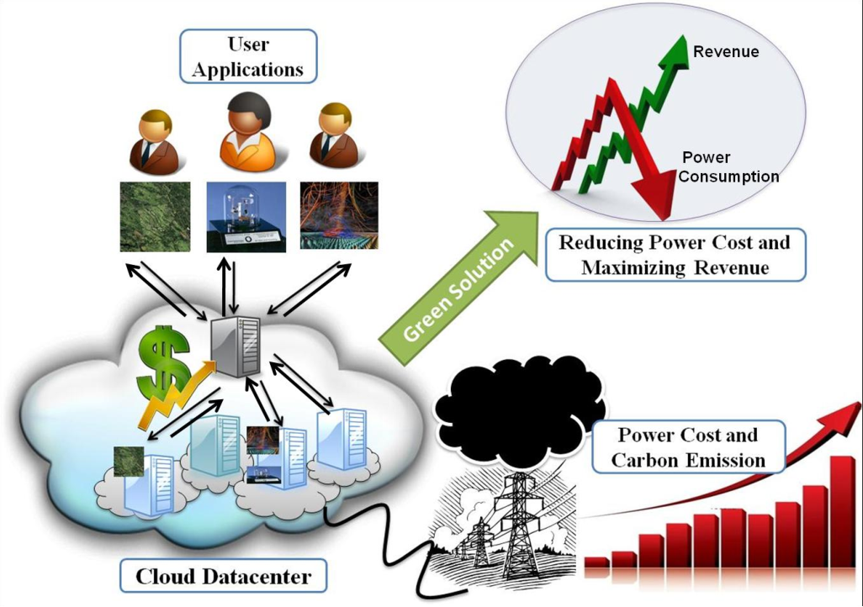
Problem Statement:
Traditional software development practices contribute to environmental degradation due to high energy consumption and electronic waste generation, exacerbating resource depletion and increasing carbon footprint. Limited adoption of green computing hampers sustainability efforts, necessitating innovative strategies to integrate environmental sustainability into modern software development processes.

Slide 3
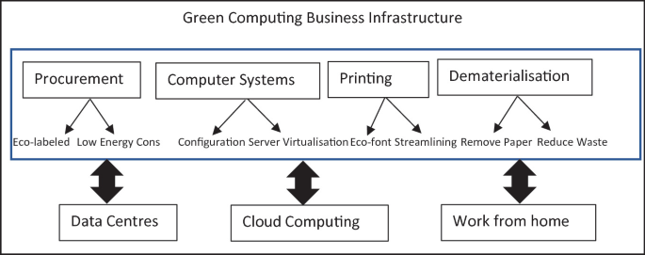
Objective:
Examine Practices and Strategies: Investigate various practices and strategies to incorporate green computing principles into software development processes.
Evaluate Impact: Assess the effects of these practices on environmental sustainability metrics, including energy consumption, carbon emissions, and electronic waste generation.
Through these objectives, the paper aims to:
Inform and Empower: Provide insights to software developers, organizations, and policymakers to make informed decisions and prioritize environmental sustainability in their operations.
Drive Action: Encourage the adoption of green computing practices to mitigate environmental impact and promote sustainable development in the software industry.

Slide 4
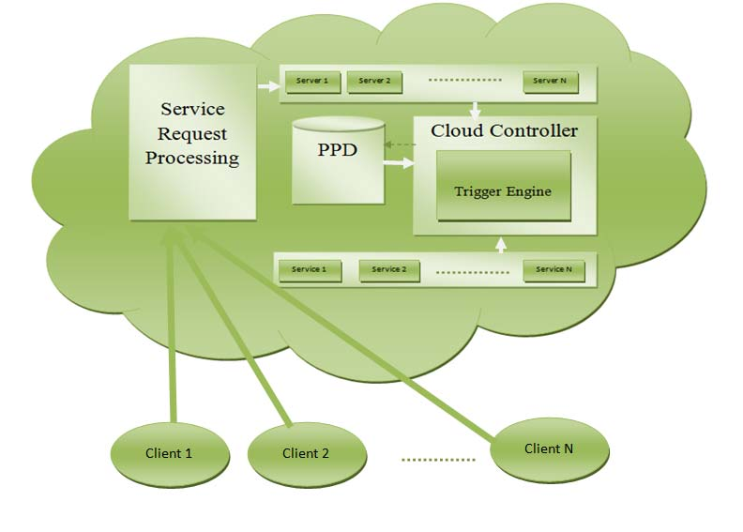
Significance:
Environmental Preservation: Green computing practices contribute to mitigating climate change and reducing the ecological footprint of software development.
Resource Conservation: By optimizing energy usage and reducing electronic waste, green computing conserves natural resources and minimizes environmental strain.
Sustainability Goals: Advancing green computing aligns with global sustainability objectives, fostering a more environmentally responsible software industry.
Cost Savings: Implementing green computing strategies can lead to reduced energy costs and operational expenses, enhancing the economic viability of software development.
Corporate Responsibility: Embracing green computing demonstrates corporate social responsibility, enhancing brand reputation and stakeholder trust.

Slide 5
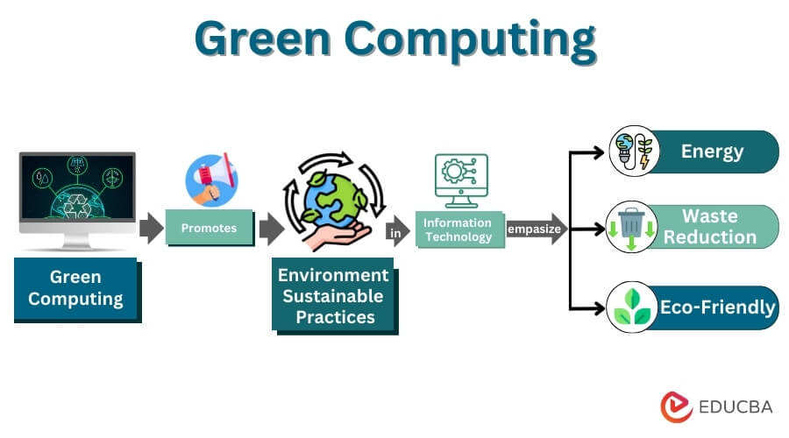
Understanding Green Computing:
Definition: Utilizing computing resources responsibly to minimize energy consumption, carbon emissions, and ecological impact.
Key Components: Energy-efficient hardware, power management techniques, eco-friendly software solutions, responsible disposal of electronic waste.
Significance: Mitigates the environmental impact of the IT industry's energy consumption and carbon emissions.
Evolution: Started with hardware-based solutions in the 1990s, now encompasses software optimization, data centre efficiency, and lifecycle management.
Impact: Promotes energy efficiency, waste reduction, and responsible resource management, contributing to a more sustainable future for the IT industry and society.
Role: Central in shaping the future of technology, aligning with corporate social responsibility objectives, and driving positive global change.

Slide 6
Thank u

